Slide 1
CSE 220
Data Structures
LAB 01: Arrays and Linked List
Anwarul Bashir Shuaib [AWBS]
Lecturer
Department of Computer Science and Engineering
BRAC University

Slide 2
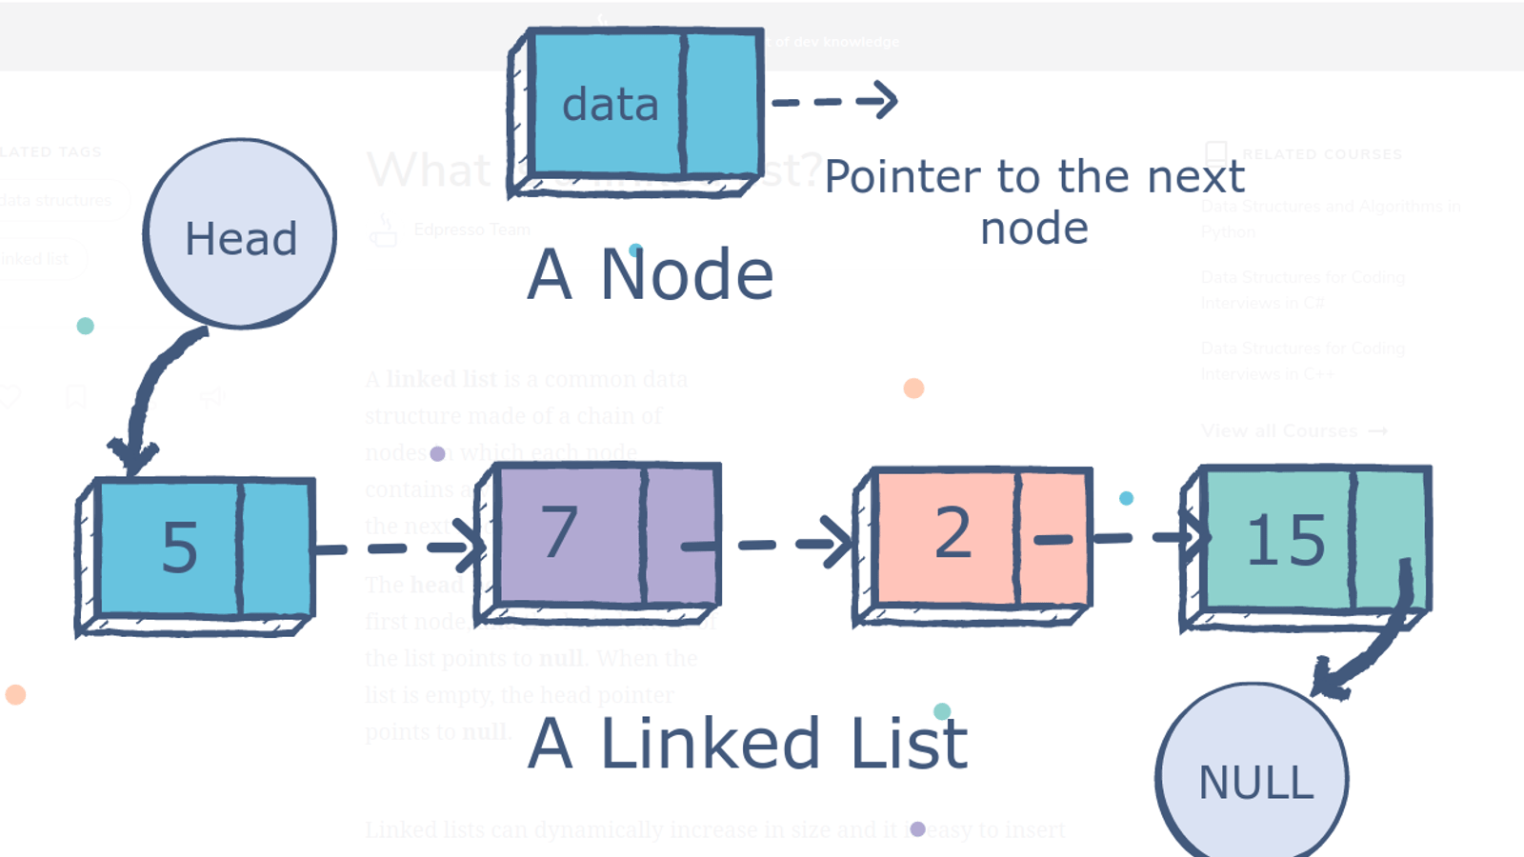
Linked List Overview
A node is the building block for linked lists.
Contains two key things:
Data
Reference to next node
https://dev.to/tastaslim/an-introduction-to-linked-list-1bmp

Slide 3
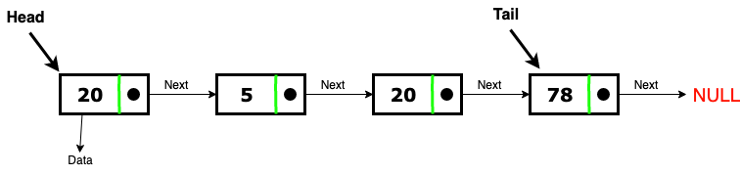
Linked List Overview
The first element is often called “head”
The last element is often called “tail”

Slide 4
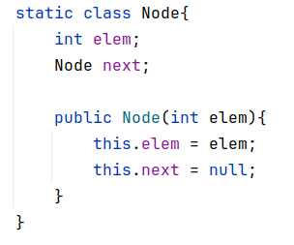

Node
Linked List

Slide 5
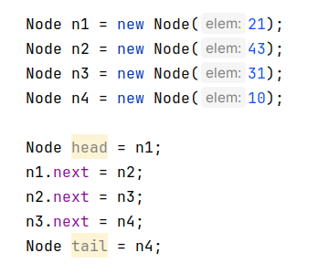
Linked List Creation
Create a linked list from these elements: 21, 43, 31, 10

Slide 6
Linked List Creation
Create a linked list from these elements: 21, 43, 31, 10
21
43
31
10
null
null
null
null

Slide 7
Linked List Creation
Create a linked list from these elements: 21, 43, 31, 10
head
21
43
31
10
null
null
null
null

Slide 8
Linked List Creation
Create a linked list from these elements: 21, 43, 31, 10
head
21
43
31
10
null
null
null

Slide 9
Linked List Creation
Create a linked list from these elements: 21, 43, 31, 10
head
21
43
31
10
null
null

Slide 10
Linked List Creation
Create a linked list from these elements: 21, 43, 31, 10
head
21
43
31
10
null

Slide 11
Linked List Creation
Create a linked list from these elements: 21, 43, 31, 10
head
tail
21
43
31
10
null

Slide 12
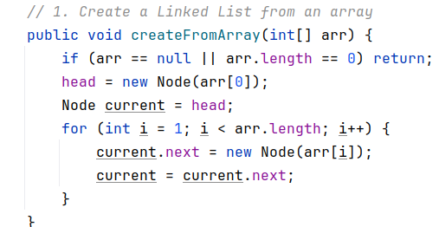

Linked List Creation
Create a linked list from an array arr = [21, 43, 31, 10]

Slide 13
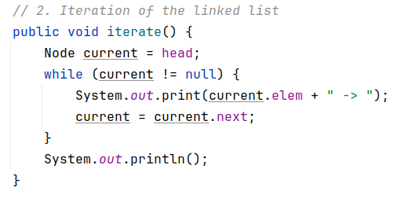
Sequential Traversal
head
tail
99
21
43
31
10
NULL
Output:

Slide 14
Sequential Traversal
current
head
tail
99
21
43
31
10
NULL
Output:

Slide 15
Sequential Traversal
current
head
tail
99
21
43
31
10
NULL
Output:

Slide 16
Sequential Traversal
current
head
tail
99
21
43
31
10
NULL
Output:
99->

Slide 17
Sequential Traversal
current
head
tail
99
21
43
31
10
NULL
Output:
99->

Slide 18
Sequential Traversal
current
head
tail
99
21
43
31
10
NULL
Output:
99->21->

Slide 19
Sequential Traversal
current
head
tail
99
21
43
31
10
NULL
Output:
99->21->43

Slide 20
Sequential Traversal
current
head
tail
99
21
43
31
10
NULL
Output:
99->21->43->31

Slide 21
Sequential Traversal
current
head
tail
99
21
43
31
10
NULL
Output:
99->21->43->31->10->

Slide 22
Sequential Traversal
head
tail
99
21
43
31
10
NULL
current
Termination condition
Output:
99->21->43->31->10->

Slide 23
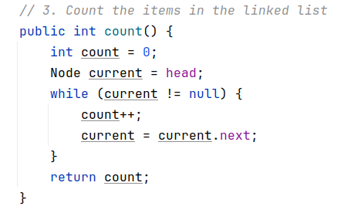
Node Count
head
tail
99
21
43
31
10
NULL

Slide 24
Node Count
head
tail
99
21
43
31
10
NULL
count = 0

Slide 25
Node Count
current
head
tail
99
21
43
31
10
NULL
count = 0

Slide 26
Node Count
current
head
tail
99
21
43
31
10
NULL
count = 0

Slide 27
Node Count
current
head
tail
99
21
43
31
10
NULL
count = 1

Slide 28
Node Count
current
head
tail
99
21
43
31
10
NULL
count = 1

Slide 29
Node Count
current
head
tail
99
21
43
31
10
NULL
count = 2

Slide 30
Node Count
current
head
tail
99
21
43
31
10
NULL
count = 3

Slide 31
Node Count
current
head
tail
99
21
43
31
10
NULL
count = 4

Slide 32
Node Count
current
head
tail
99
21
43
31
10
NULL
count = 5

Slide 33
Node Count
head
tail
99
21
43
31
10
NULL
current
count = 5
Termination

Slide 34
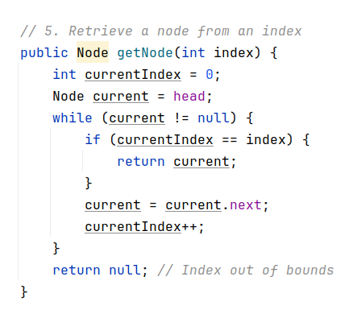
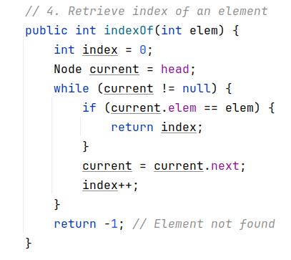
Element Access

